Slide 1
Welcome: The Critical Role of IT Admins
10:00am - 10:30am EDT | 4:00pm - 4:30pm CEST
SESSION 01 — STARTING SOON

Slide 2
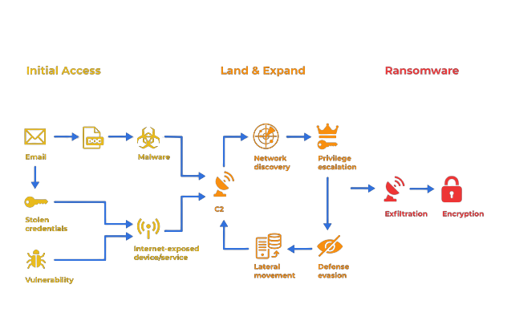
Cost / Impact / Expertise Needed to Address
Often automated. Weakest links in attack chain to break. Nip it in the bud.
Shifting to hands-on-keyboard.
PRIORITY: “Reduce/control the self-install attack surface.” — Jon Hencinski

Slide 3
“Tech gives you viz, configs are how you win.”
Jon Hencinski
VP Security Operations at Excel

Slide 4
https://thedfirreport.com/
2022 Year in Review
Malicious ISO File Leads to Domain-Wide Ransomware
IcedID to XingLocker Ransomware in 24 Hours
NetWalker Ransomware in 1 Hour

Slide 5
2022 Year in Review tl;dr
Initial access
Nearly 7 in 10 gained access via phishing
Shift from macros to ISO and ZIP files containing LNK shortcuts
Persistence
Scheduled task creation
Creating local admin accounts
Rise in remote access tool abuse (Atera, AnyDesk, etc.)
Credential access
Nearly half of attacks targeted LSASS
Discovery
AdFind
Invoke-ShareFinder
Lateral Movement
RDP & SMB/Windows Admin Shares
WMI or PsExec for execution
Exfiltration
Rclone

Slide 6
You

