Slide 1
Defense Workshop 2: Credential Abuse
Josh Schofield
Principal Product Manager at NinjaOne

Slide 2
Why are we here today?
What is happening in the “wild”
Why is this important?
What are some general best practices?
How can ninjaOne help?

Slide 3
Recent Security Incidents/Breaches
It’s been an active few months
Activision | December 2022¹
PayPal | January 2023²
Atlassian | February 2023³
Method: Phishing - Text Message
Impact: Threat actors exfiltrated sensitive employee data and information about yet-to-be-released game content.
Possible Mitigations: MFA, Access Policies, Training
Method: Credential Stuffing
Impact: Unknown impact. Threat actors were able to access systems with valid credentials from other, unrelated, data breaches. Possible Mitigation: MFA, Access Policies
Method: Password in Public Repo
Impact: Threat actors obtained and were able to leak current employees’ data as well as floor plans for select company offices.
Possible Mitigation: MFA, Access Policies, Training
¹ https://tech.co/news/activision-data-breach
² https://www.bleepingcomputer.com/news/security/paypal-accounts-breached-in-large-scale-credential-stuffing-attack/
³ https://cyberscoop.com/atlassian-hack-employee-data-seigedsec

Slide 4
Why is this important?
Attacks on Small-Medium Sized business are increasing
A recent Accenture study shows that 43% of cyber attacks are targeted at small businesses
82% of breaches involve some human element

Slide 5
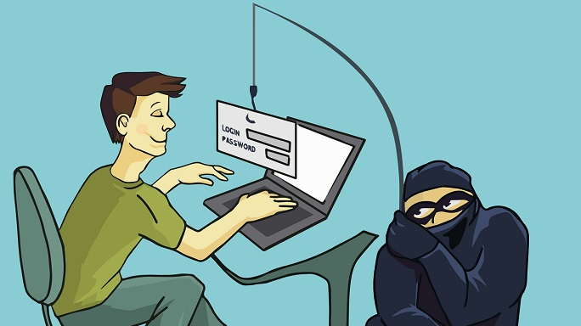
I think I am getting a bite

Slide 6
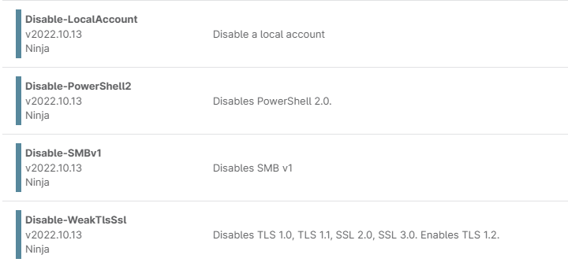
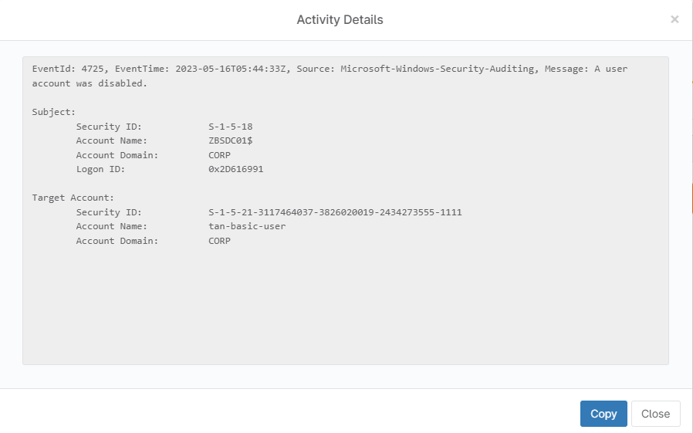
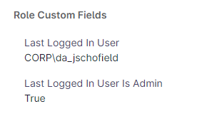
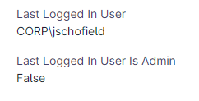
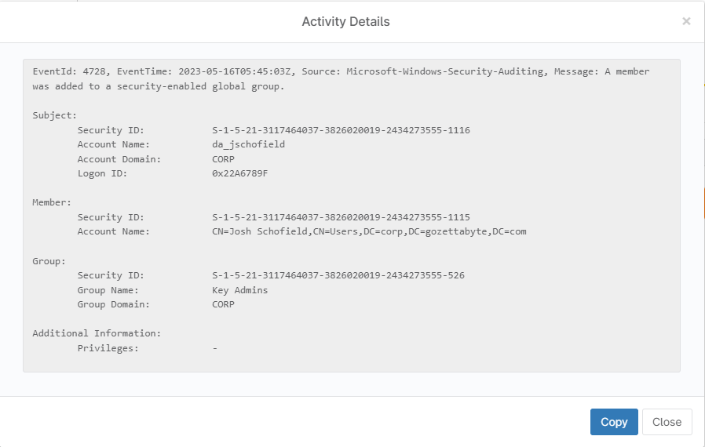
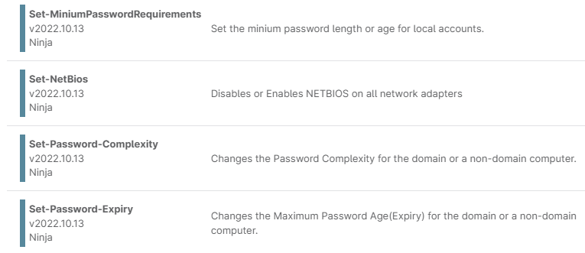
What can you do?
Identify
Secure
Monitor
Defend
Admin accounts
Access locations
Critical systems/applications
Critical accounts
Patch/update
Enforce password policies
Limit Cached Logons
Failed logins
Locked accounts
Unexpected access locations
Event logs (group/user changes)
Unexpected Account Usage
Lock accounts
Force password/MFA resets
Remove devices from network
Update access/password policies
Leverage password manager
User Training
User Training
Enforce MFA
Notes:
Protect accounts
MFA wherever possible, especially with privileged or admin accounts
Passwordless logon
Password managers which allow for easy creation of passwords which do not need to be remembered, allowing for stronger complexity
Reduce and Remove Administrator logons
Reduce Attack Surface
Patch
Look for open shares on the network
Be vigilant
Monitor for Addition/Removal of group memberships
Monitor for local account creation
Monitor for service account interactive logon
Educate your users
Phishing campaigns
Education on MFA and why it’s important

Slide 7
Community Content Managing Local Admin Accounts with ninjaOne
Michael Mason, System Administrator II

Slide 8
Community Content Managing Local Admin Accounts with ninjaOne
Michael Mason, System Administrator II
https://github.com/mikerm19/Ninja/blob/main/laps

Slide 9
Thank You

